Slide 1
What is Machine Learning

Slide 2
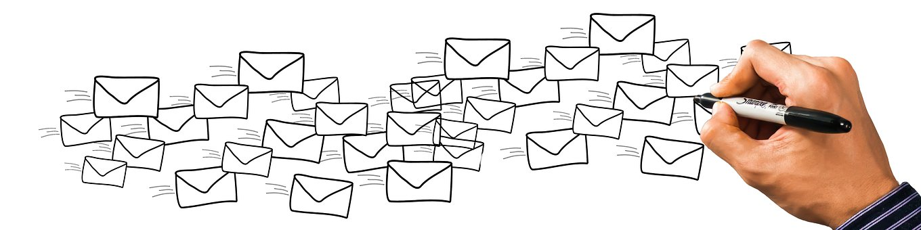
How many email we get daily

Slide 3
Which email are important or Not Important
We create rule.
Automation
If Mail Comes from ‘R1,R2,R3’
move to folder a1.
If Mail title has ‘Job’
Important mail

Slide 4
Problem
Manual Rule creation
Rule needs to update

Slide 5
Can we think ahead of automation
Can such rules be created automatically.
Automation of automation
Machine Learning

Slide 6


Machine Learning
Machine Learning system
If Mail Comes from ‘R1,R2,R3’
move to folder a1.
If Mail title has ‘Job’
Important mail
Automation of Automation

